Slide 2
WebEx Meeting Information
Sign-in with name, company name and contact information in the WebEx chat box
Presentation has been posted on the SAWS website at:
  https://apps.saws.org/business_center/ContractSol/Drill.cfm?id=3932&View=Yes
Submit questions at the end of today's presentation
  Submit your question in the chat box, or
  Send an email to Florinda Gonzales at Florinda.Gonzales@saws.org
SAWS will read questions aloud
Please mute your devices during the meeting

Slide 3
Oral Statements
Oral statements or discussions during this Pre-Submittal Conference will not be binding, nor will they change or affect the RFQ or the terms and conditions of the contract. Changes, if any, will be addressed in writing only via an Addendum.

Slide 4
Agenda
General Project Information
Project Requirements
Submission Restrictions and Requirements
Selection Process
Evaluation Criteria
Submittal Packet Preparation
Addendums
Key Dates
Electronic Submission
Communication Reminders
Project Overview (to include Locations and Scope of Services)
Additional Requirements
Questions
Notes:
DIANA
Here is a list of topics that we intend to discuss today.
REVIEW SLIDE
I am going to turn it over to Julie Valadez, the Project Manager to provide an overview on the project itself, as well as SAWS service centers.

Slide 5
General Project Information
Utilizing the Design-Build alternative construction delivery method under Texas Government Code 2269.301 to select a single, qualified independent DB firm that will provide the best value to SAWS
Estimated cost: $27.2 million
Two (2) Project Worksites
  Design and construction services for a new Northeast Operations Center (located on a green field site in NE Bexar County)
  Design and construction services to demolish existing administration building and signage, as well as demolish and remediate existing diesel underground storage tanks, associated pumps, and utilities at the existing Northeast Service Center.
    This scope also includes pavement replacement, directional striping, guardrails and new marquee signage.
Design Criteria Package (DCP) and DB Agreement are posted on the SAWS’ website

Slide 6
Project Requirements
Submitting a Response
DB firm must select A/E team members in accordance with 2254.004 of Texas Government Code who are licensed to practice in Texas
  Key personnel should include USGBC LEED certified and LEED professionals knowledgeable in developing and administrating pertinent requirements and stipulations
Review insurance coverage with insurance broker (See Exhibit 13 of the DB Agreement)
  Must ensure compliance or that variances will be resolved during negotiation, if selected
  If short-listed, Statement of Compliance with Owner Insurance Requirements (Attachment E)
  If selected for negotiations, provide full insurance policies of DB firm within 48 hours of request
If short-listed, submit a Bid Bond for 5% of estimated cost
  Upon execution of DB Agreement, DB Firm will provide a Security Bond (Bid Bond released)
  Once Final GMP is established, submit Performance and Payment Bonds, which excluding the design portion (Security Bond will be released)

Slide 7
Project Requirements
Submitting a Response
During evaluation period and up until award, Respondent may not change team members identified in organizational chart
  If a circumstance does occur during the procurement process, Respondent shall notify SAWS as soon as possible
  SAWS may allow Respondent to replace the key team member with alternate who possesses equal or better qualifications and experience
Per SAWS Ethics Policy, a former SAWS employee may not serve in a lead role as a key team member for a period of 2 years from termination of employment
  Failure to adhere may result in Respondent's proposal being found non-responsive or a reduction in points
Financial Statements for last 3 years required to be submitted with proposal
  Respondent must clearly indicate legal entity being proposed
  Guaranty Agreement in favor of SAWS is allowable, but not required
  Respondent may be rejected if the firm does not possess the financial strength and capacity to undertake the Project

Slide 8
Project Requirements
Contract
Obtain COSA and AHJ permits
Coordinate and schedule the performance of the services and work for staging and move-in; SAWS will purchase furniture
Adhere to Government Code Chapter 552, subchapter J to preserve contracting documents
Ensure LEED equivalent certification for new administration building and other buildings completed based on energy efficient and environmentally conscientious designs and meet energy related codes per AHJ.
Utilize SAWS’ Contract and Project Management System (CPMS) to invoice and manage project documents
DPOR to develop and provide design deliverables utilizing a BIM model environment (and convert int AutoCAD (*dwg) format
Provide signed Form 1295 (TEC website) with signed DB Agreement

Slide 9
Project Requirements
Contract
Adhere to prevailing wage rates per Texas Government Code 2258
Wage decisions found in the DB Agreement
  May be updated up to deadline of the RFP if changed by DOL
Payroll records are subject to review
Utilize LCP Tracker software to submit certified payroll on a weekly basis
Contractors are responsible for sub-contractor payroll
Late payrolls delay contractor payments from SAWS
Site visits are random and unannounced
Interviews will be conducted and will be private & confidential
All apprenticeship programs will need to be approved by DOL prior to starting

Slide 10
Post Award: Subcontractor Payment & Utilization Reporting (S.P.U.R.) System
Project Requirements
Contract
1. Subcontractor & Supplier Payment Tracking
2. Subcontractor and Supplier Additions or Substitutions
3. LCP Tracker
4. Must be Current and Accurate before Retainage is released
https://saws.smwbe.com

Slide 11
Submission Restrictions
As clarified in Addendum 1
Firms that are partners or sub-consultants, and/or have an ongoing role with the PM (APSI) may not submit for this RFQ or serve on a team of the DB firm
Specifically, Munoz & Company, Cleary Zimmerman Engineers, K Friese & Associates, Professional Services Industries (PSI) and US Cost

Slide 12
Submission Requirements
Respondents must have previous DB experience and projects selected for the proposal must demonstrate that experience
The lead Project Manager must also demonstrate DB experience
SAWS prefers that the DB firm's proposed DPOR has A/E experience on DB project(s)
DB firms commits to maintain the employment of and to not replace the Project Manager throughout the Design and Construction of the Project.

Slide 13
Selection Process
Step 1 - Requests for Qualifications (RFQ)
    Submittals scored per published Evaluation Criteria
    No greater than 5 firms will be short listed
Step 2 - Request for Proposals (RFP) to short-listed firms only
    - Attachment E & Bid Bonds (Due within 7 days of RFP issuance)
    - Site visits
    Interviews, if necessary
  Proposals scored from published Evaluation Criteria
  Selected firm notified and negotiations begin
    Conduct Worksite investigation: SAWS will provide a Worksite Investigation Stipend for use by the selected DB firm to produce a Worksite Investigation Report submitted to negotiate a reasonable Worksite Conditions Allowance (See Section IX of the DB Agreement)
    If negotiation is unsuccessful, SAWS will keep the Worksite Investigation Report

Slide 14
Evaluation Criteria
Page | CRITERIA | MAX POINTS AVAILABLE | MAX PAGES ALLOWED
13-15 | Proposed Team Members/Comparable Experience DB Firm: (Note: Specific information required on Resumes and Project sheets) | 25 points | 15 (does not include resumes)
15 | Proposed Team Members/Comparable Project Experience DPOR: (Note: Specific information required on Resumes and Project sheets) | 25 points | 15 (does not include resumes)
15-18 | Project Approach | 25 points | 15
18-19 | Quality Assurance/Quality Control established processed | 10 points | 5
19 | Small, Minority, Woman, and Veteran-Owned Business (SMWVB) | 15 points | 5
 | TOTAL | 100 points | 55 pages max

Slide 15
Evaluation Criteria
Proposed Team Members/Comparable Experience: DB Firm – 25 Points
Summary and Organizational Chart of Proposed Project Team
  Team Introduction/Organizational Charts
  Staffing Commitments including percentages
  Staffing and Succession Plans (Attachment C of the RFQ)
  Previous Project Collaboration
  Identify additional skills, experience, and qualifications that distinguish Respondent's firm/team related to the specific scope of Work and Services
Key Personnel/Resumes (One page per person; 6 required items)
Firm Experience
Design-Build Coordination Experience
Past Project Experience of DB Firm
  Project Sheets for 3 relevant projects of similar size and scope performed by DB firm in the last 10 years (a.-h.). Proposed team members should have worked on these projects.
Subcontract Management

Slide 16
Evaluation Criteria
Proposed Team Members/Comparable Experience: DPOR- 25 Points
Summary and Organizational Chart of Proposed Project Team
  Team Introduction/Organizational Charts
  Staffing Commitments
  Staffing and Succession Plans
  Previous Project Collaboration
  Identify additional skills, experience, and qualifications that distinguish Respondent's firm/team related to the specific scope of Work and Services
Key Personnel/Resumes
Firm Experience
Design-Build Coordination Experience
Past Project Experience of DPOR
  Project Sheets for 3 relevant projects of similar size and scope performed by DPOR firm in the last 10 years (a.-h.) Proposed Team members should have worked on these projects.
  Project Sheets for 3 relevant projects of similar size and scope performed by Civil Engineering firm in the last 10 years. Proposed Team members should have worked on these projects.
  8 key items to include as part of project information

Slide 17
Evaluation Criteria
Project Approach – 15 Points
Summary of Project Approach (3 items)
  Understanding Scope of Work and DCP, as well as Design and Construction Approach
General Coordination (3 items)
  Coordination/Communication
  CPMS Document Control and Status Reporting
  Project Commissioning, Turnover, and Final Close-out
Guaranteed Maximum Price (GMP) Approach and Adherence (4 items)
  Do not include any fees or prices
Schedule Approach, Recovery Schedule and Project Status Reports (4 items)
  Schedule Approach and Innovation
  Risk Identification, Assessment, Analysis and Mitigation Plan (including Range of cost to conduct Worksite Investigation)
  Permitting Tracking and Methodology
  Recovery Schedule
Safety Program and Records
  Summary of firm's safety record for specific projects identified in Respondent's proposal
  Safety Procedures Plan (to include 17 items)
  Does not count towards the page count

Slide 18
Evaluation Criteria
Quality Assurance/Quality Control Established Processes – 10 Points
Detailed step by step from start of project to completion (for the Design and Construction Phase)
DB firm's QA/QC processes for oversight and management of DPOR and their subconsultants
DPOR's internal QA/QC processes for ensuring drawing and specification completeness, conflict check and resolution across disciplines, compliance with Owner's scope and standards, and completion of final as-built submittal.
Both entities shall show their QA/QC processes address the 9 questions.
  DB firm and DPOR should coordinate their responses as it relates to the QA/QC processes with each other

Slide 19
Evaluation Criteria
Small, Minority, Woman, and Veteran-Owned Businesses (SMWVB) Program – 15 Points
RFQ Scoring
Five Narrative Questions Up to three points may be awarded per answer, for a total of up to 15 points.
Questions related to the SMWVB Program, or scoring of the RFQ may be directed to the SMWVB Program Manager until the submittal date.
Marisol V. Robles, SMWVB Program Manager
Email: Marisol.Robles@saws.org
Telephone: 210-233-3420

Slide 20
Submittal Packet Preparation
Tabs
Tab 1 - Attachment D (Submittal Response Checklist)
Tab 2 - Respondent Questionnaire
Tab 3 - W9 Form
Tab 4 - Evaluation Criteria
  A for Proposed Team Members/Comparable Experience: DB Firm
  B for Proposed Team Members/Comparable Experience: DPOR
  C for Project Approach
  D for Quality Assurance/Quality Control Established Processes
  E for SMWVB
Tab 5 - Financial Statements
Tab 6 - Attachment A (Conflict of Interest Questionnaire)
Tab 7 - Safety Procedures Plan

Slide 21
Submittal Packet Preparation
Tab 4 - A & B
Attachment C - Staffing Plan for DB Firm and DPOR (includes Org chart with Civil PM identified)
Resumes for all key team members proposed for this Project (1 pg/6 items)
Project Sheets
  Similar size and scope (new construction/demolition/renovations)
  Public municipalities, similar industrial or light commercial operations, or similar building typology
  All contact information of project Owner (previously verified)
  Key personnel and their specific tasks and role on this DB project

Slide 22
Submittal Packet Preparation (cont.)
  Total of 9 Project Sheets (3 for DB firm, 3 for DPOR, and 3 for Civil Engineering team)
Project selected should include key personnel on DB firms proposed team
Utilize Attachment D- Submittal Response Checklist, which identifies the pages numbers in the RFQ, as well as dually assists with:
  Tabs
  Identification of required documents and page limits

Slide 23
Submittal Packet Preparation
Thoroughly read and become familiar with the entire RFQ and DCP and ask any questions.
Ensure there is a response to each item identified within the Evaluation Criteria to minimize point reduction.
Ensure submittal clearly shows that the DB firm and DPOR collaborated on the SOQ submission, and that it reads as a cohesive document.
Be very specific and avoid “boiler plate” responses.
Ensure all required documents are submitted and signed, when applicable
(i.e. Respondent Questionnaire, CIQ, etc.)
Contact the SMWVB Program Manager for assistance, if necessary
Perform a thorough QA/QC review on submittal before submitting

Slide 24
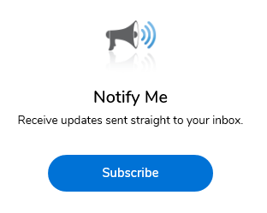
Addendums
Receive notification directly in your email “Inbox”.
Download documents.
Subscribe using the Notify Me button
Check SAWS website often and before
submitting for this RFQ
Multiple Addendums will be issued
https://apps.saws.org/Business_Center/Contractsol/

Slide 25
Key Dates
March 19, 2021 by 4:00 p.m. Receipt of Written Questions Due
March 24, 2021 by 4:00 p.m. Q & A Posted to Website
April 7, 2021 by 2:00 p.m. Deadline to request FTP Site Access
April 8, 2021 by 2:00 p.m. Submittals Due
April 9-21, 2021 Submittals Evaluated and Respondent Notification
April 26, 2021 RFP Issued to short-listed firms/Site visits scheduled
May 5, 2021 Mandatory Pre-Proposal Mtg and Site Visits (Short Listed Firms )
May 12, 2021 Attachment E and Bid Bond are Due
June 2, 2021 RFP’s Due to SAWS
June 2-15, 2021 RFP's evaluated
June 16-18, 2021 Interviews, if necessary
June 2021 Selected Firm Notified
June - July 2021 Site investigation and Negotiations
September 13, 2021 SAWS Board Consideration and Award
September 2021 Non-Selection Notice Mailed
September 2021 Start Work
*Dates are subject to change

Slide 26
Electronic Submission
FTP access requests are being accepting now, but no later than April 7, 2021 by 2:00 PM CDT
  Email Florinda Gonzales with legal name and recipient's email address and phone number
Title the proposal “PS-00106 Northeast Service Center DB Project RFQ Response” and name of Respondent
One (1) file per Respondent
  See Exhibit D Submittal Response Checklist
  8 1/2" x 11" portrait format (11" x 17" permitted where warranted)
  PDF format with seven (7) TABS (and subtabs in Tab 4) bookmarked by including the Table of Contents function for easy access
Allow sufficient time to upload; SAWS recommends no later than 2 hours prior to the deadline
Responses are due no later than April 8, 2021 at 2:00 p.m. CDT
Late responses will not be accepted and will not be downloaded

Slide 27
Communication Reminders
Respondents shall not communicate with the following:
  SAWS’ Executive Management, SAWS’ Project Manager or any other SAWS’ staff
  SAWS’ Program Manager (APSI)
  City Council member of staff
  SAWS Board of Trustees
This includes phone calls, emails, letter, or any direct or indirect discussion of the RFQ (or forthcoming RFP)
Violation of this provision may result in Respondent disqualification for consideration
Communication protocol is in effect up until Board award of the Contract.

Slide 28
Project Overview
Scope of services and work will take place on two distinct sites and work will consist of planning, development, design, engineering, procurement, demolition and construction.
Attachment E: Design Build Services Agreement
Exhibit 1: Design Criteria Packet (DCP) includes:
Program Manager’s Survey and Geotech
Plans and Specs from previous Phases
Detailed room data /room sizes/ finishes
Performance Spec
Judson Road infrastructure plans

Slide 29

Project Location and Scope
New Northeast Operations Center (NEOC):
Design and construct a new Operations Center on a greenfield site at Judson Rd and Loop1604.
Modeled after the North Side Operations Center
Existing NESC at Naco Pump Station site:
Demolish and remediate existing fuel islands, UGTs, and administration building at the existing Northeast Service Center Site at O’Connor Rd.
NEOC
NSOC
NESC
WSOC
ESSC
Notes:
Site purchased in 2017 – $1.49 mil ,on a quarry zoned site so no other development and no interest in purchase. By planning ahead, SAWS avoided buying land at a premium.. Now going for 4 or 5 times that cost. Cost to highways, and surrounded by Quarries, better suited with like use/ industrial – better response time to Sonterra, TPC, EARZ – outside and inside 1604.
2021 CIP $28.1 mil
• Property is purchased
• Funding is in place
• Local interest from A/E and builder community
• Working conditions/safety and a clean safe environment a priority
• Remove fuel and D&C dispatch from the Naco Production site

Slide 30
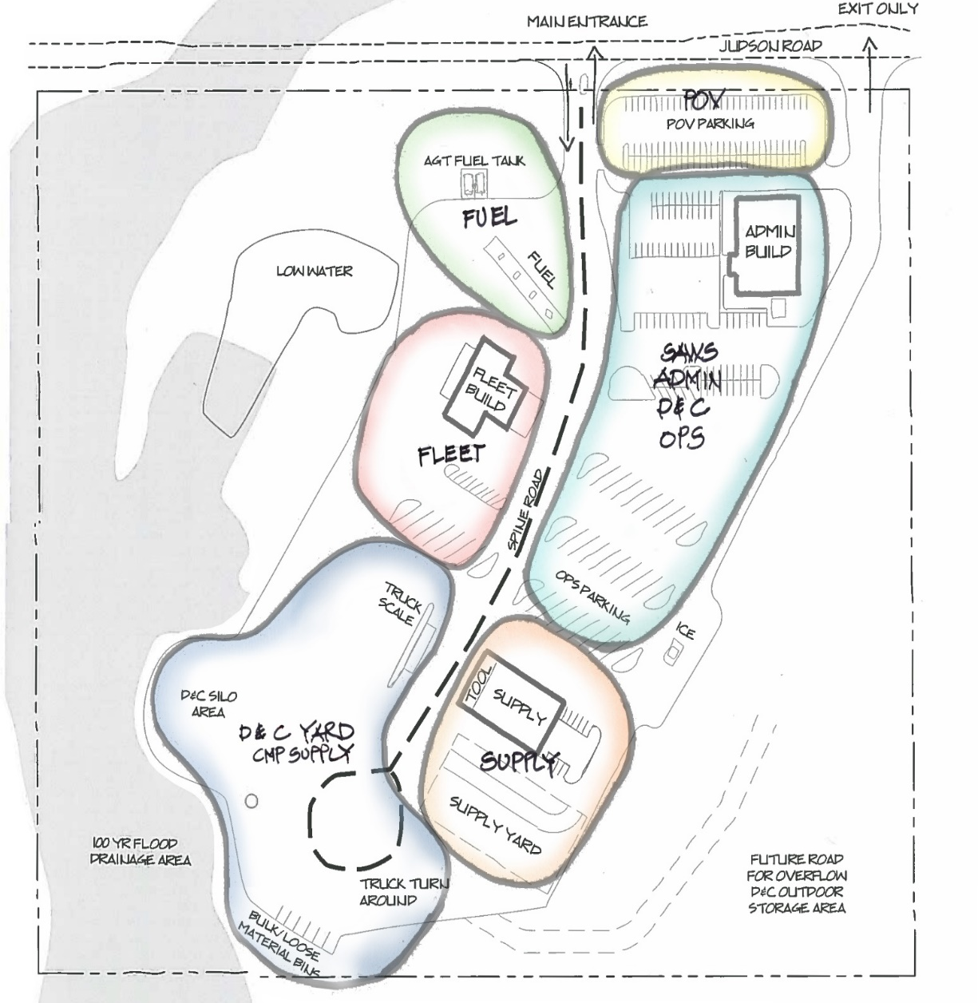
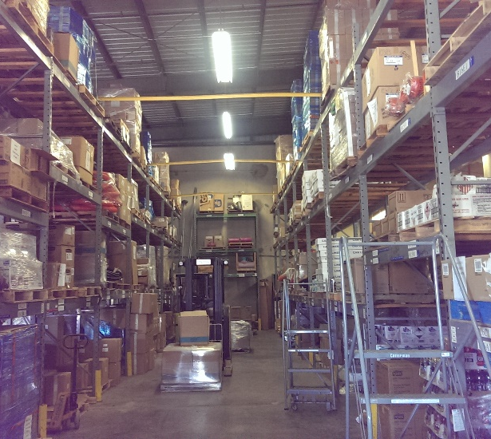
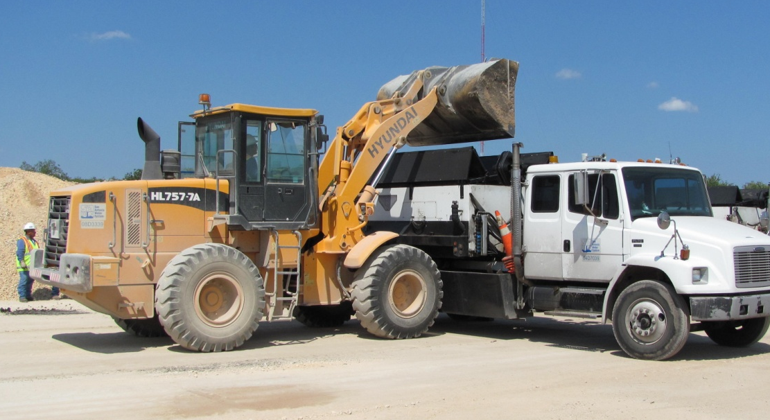
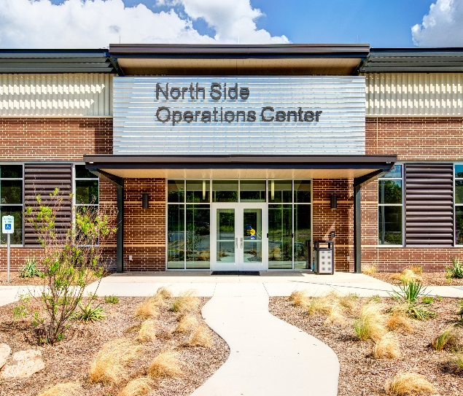
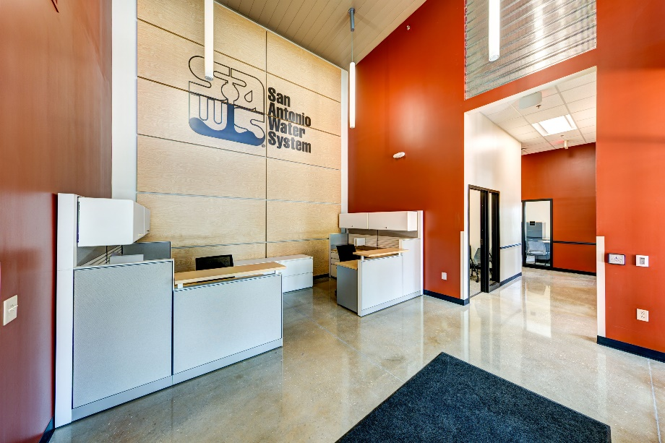
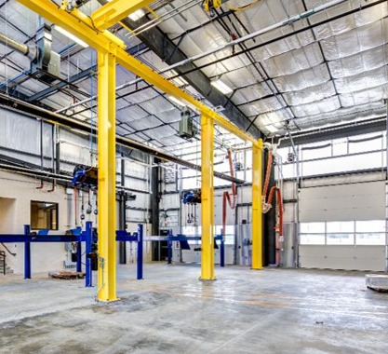
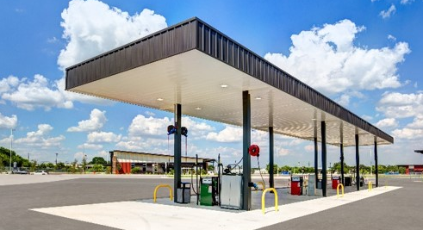
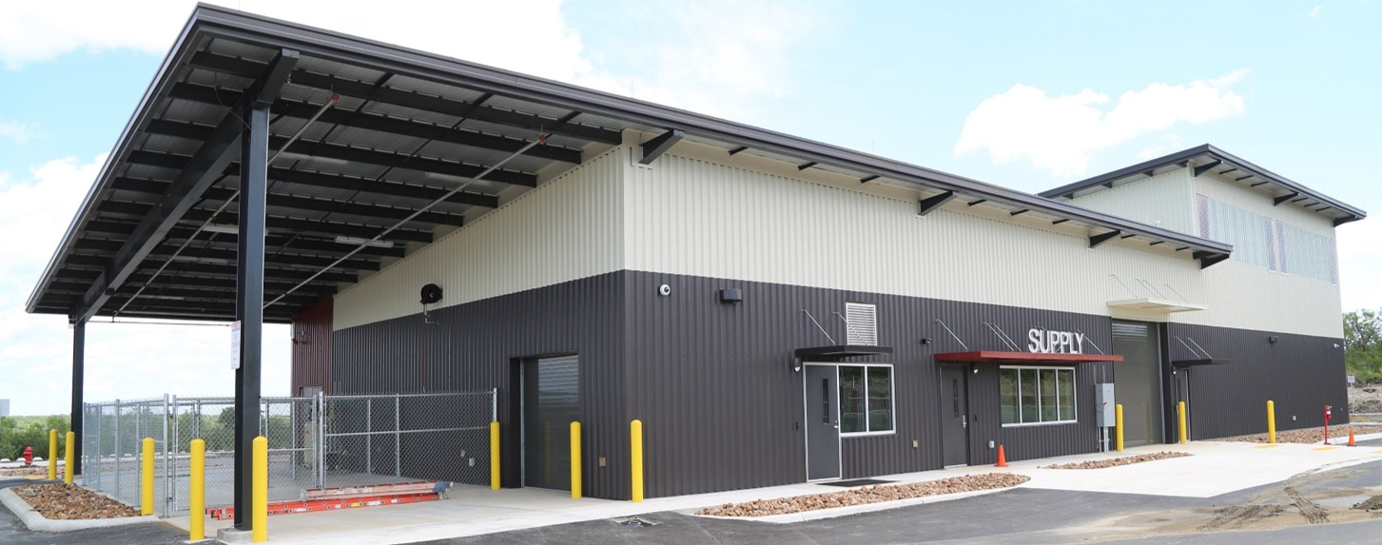
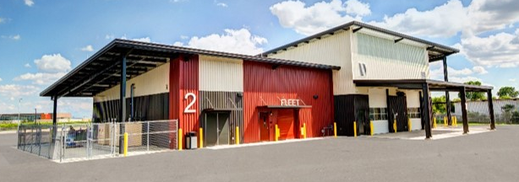
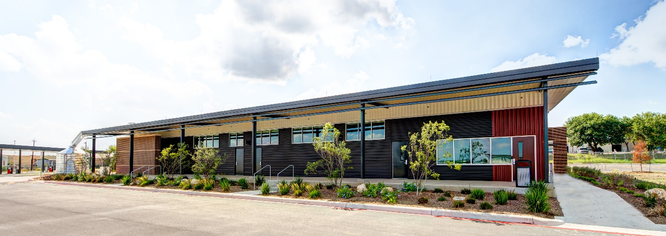
New Operation Center Overview
Bubble Diagram of New NEOC
Notes:
As shown on the previous slides, service centers play a key support function for our crews.
This aerial photo of Eastside shows the wide variety of functions at our service centers.
SAWS service fleet is housed here. This is where all vehicle maintenance is performed onsite. This includes our standard vehicles as well as heavy equipment such as backhoes, front-end loaders and dump trucks.
All of our service centers have fueling stations.
In addition, most of the fill materials and pipe supply needed by our crews are stored onsite to expedite service to our customers.
Finally, as you can see here, Eastside Service Center has areas for crews to dispose of spoils from excavations as well as areas to perform training and safety exercises.

Slide 31
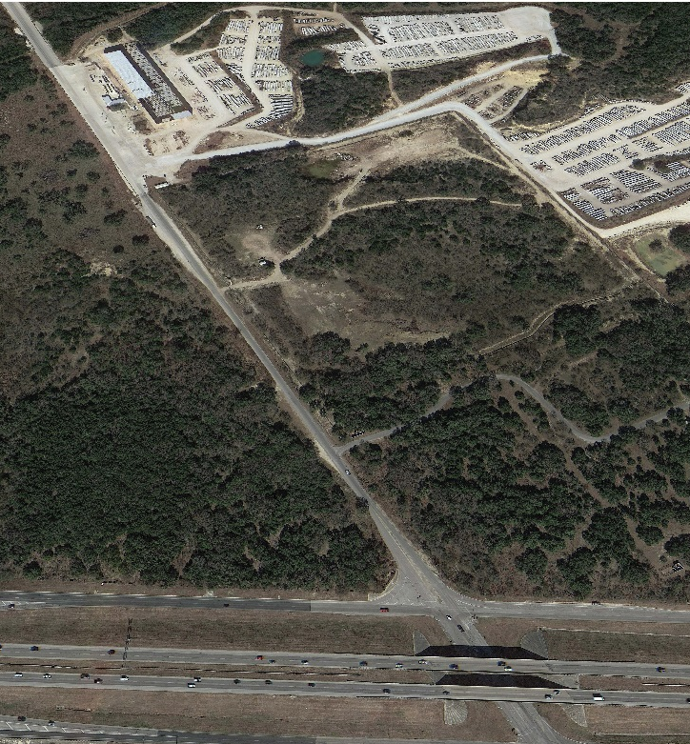
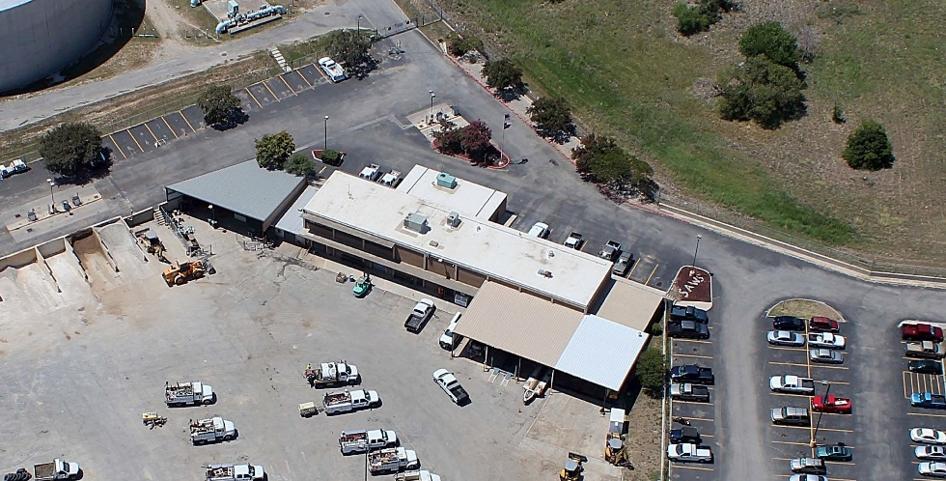
Project timeframe and sites
DB Firm selected and starts Design
Construction complete at new NEOC
SAWS relocates crews from old NESC
Old NESC site remediation and demo
JUDSON RD
1604
Notes:
Site purchased in 2017 – $1.49 mil ,on a quarry zoned site so no other development and no interest in purchase. By planning ahead, SAWS avoided buying land at a premium.. Now going for 4 or 5 times that cost. Cost to highways, and surrounded by Quarries, better suited with like use/ industrial – better response time to Sonterra, TPC, EARZ – outside and inside 1604.
2021 CIP $28.1 mil
• Property is purchased
• Funding is in place
• Local interest from A/E and builder community
• Working conditions/safety and a clean safe environment a priority
• Remove fuel and D&C dispatch from the Naco Production site

Slide 32


Project Overview
Communication Plan
SAWS Project Manager
Program
Manager
Selected Design-Build Firm
Design Team
Construction Team
Architect of Record
Superintendents
Engineers
Estimators
Subcontractors
Permits
Enhanced Commissioning
Code Consultants
Schedulers
Suppliers
Manufacturers

Slide 33
Questions
Questions are defined in the RFQ as follows:
Technical questions are those of a procedural nature, regarding the solicitation process, and questions intended to better understand the Scope of Services and Work.
Non-technical questions are those concerning the terms of the Agreement or other matters not related to scope and matters of procedure.
  Non-technical questions shall be deferred until a Respondent has been selected to commence negotiations.
Notes:
If you have any questions, they must be submitted in writing via email or fax no later Monday, February 3, 2014 at 4:00 p.m.
I am the primary POC. So, all questions go directly to me.
My business cards, along with Marisol’s are on the sign-in table at the entrance.

Slide 34
Questions
Technical questions should be submitted no later than March19, 2021 at 4:00 p.m. CDT
Must be in writing, by email or fax to:
  Florinda Gonzales
  Contract Administration Department
  San Antonio Water System
  Florinda.Gonzales@saws.org
  Fax No.: 210.233.4253
Non-technical questions will not be accepted
Notes:
If you have any questions, they must be submitted in writing via email or fax no later Monday, February 3, 2014 at 4:00 p.m.
I am the primary POC. So, all questions go directly to me.
My business cards, along with Marisol’s are on the sign-in table at the entrance.

Slide 35

QUESTIONS
(Submit through WebEx chat or via email to Florinda.Gonzales@saws.org
)

Slide 37
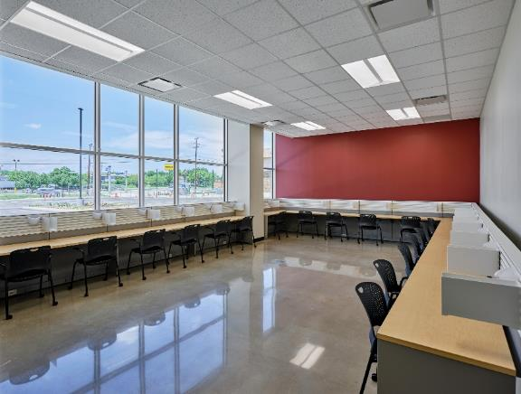
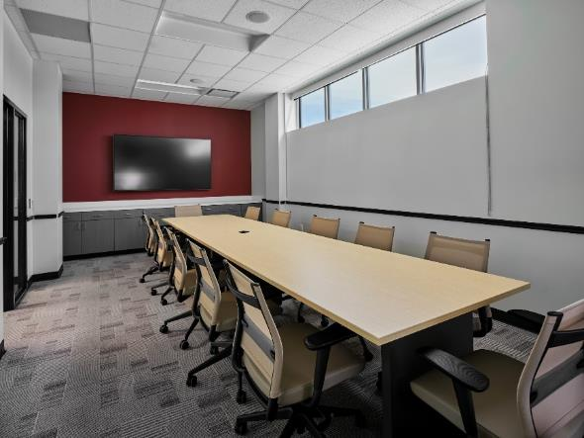

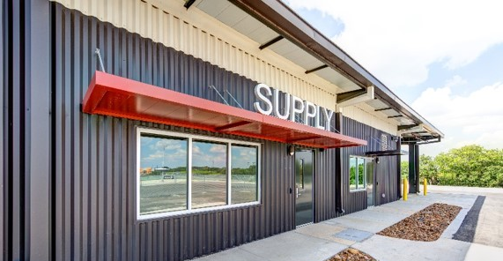
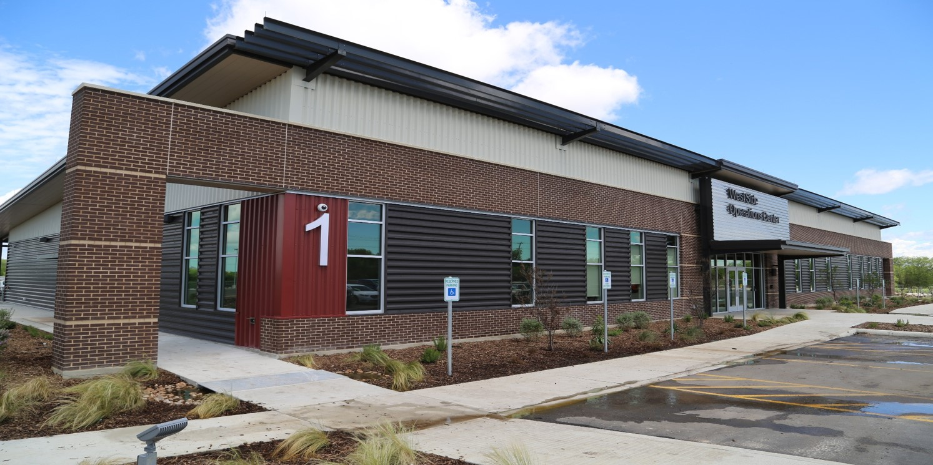
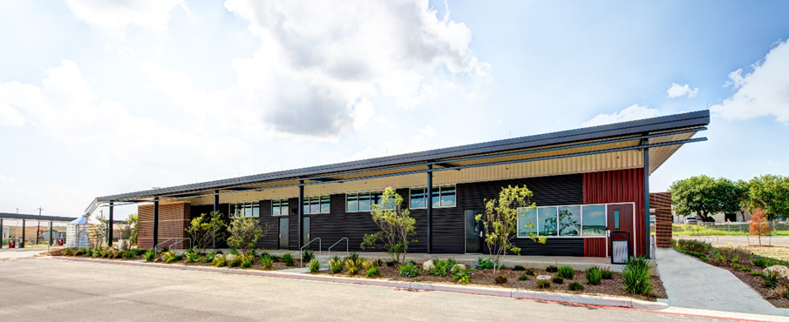
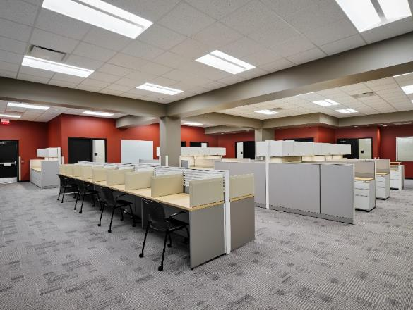

Use of utilitarian industrial metal buildings:
Notes:
Simple metal buildings with enhanced envelope to meet Energy Code. Branded campus/ standardized colors & materials to create efficiencies for SAWS Facilities. Most are tucked into industrial sites, but street views are aesthetically pleasing, and ESOC – anchor site / highly visible.. Has seen a drastic improvement – (transition statement)

Slide 38
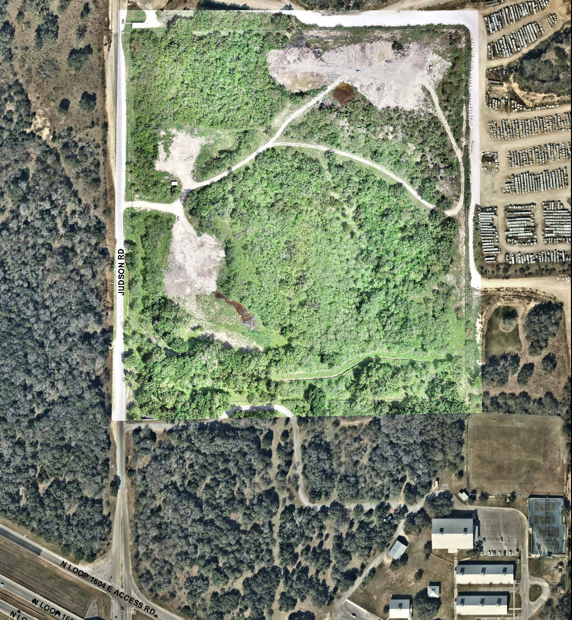
New Northeast
Operations Center Site
Aerial view
JUDSON RD.
N LOOP 1604

Slide 39
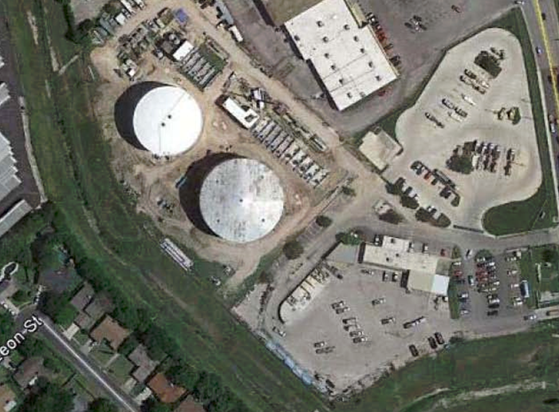

Existing Northeast
Service Center
Aerial view

